Slide 1


Thank you
Lecture 6: Time Value of Money – Part 2
The Basics of Time Value of Money
Presentation to Cox Business Students
FINA 3320: Financial Management

Slide 2
Purpose of This Lecture
Gain an understanding of the basics of time value of money pertaining to assets with multiple cash flows
    (1) Multiple Cash Flows (i.e., PMTs)
    (2) Ordinary Annuities and Annuities Due
    (3) Perpetuities
    (4) Uneven Cash Flows

Slide 3
On Valuation
Asset: Anything that generates cash flows for its owner
Valuation: Process of assigning a value to an asset
  Amounts to finding the present value of cash flows asset generates
  Examples so far…
    We valued assets generating single cash flows for their owners
    But that need not be the case!

Slide 4
Valuation Examples
A piece of art will generate a future cash flow when it is sold. Should you buy it today?
Your education will generate a stream of future cash flows for you throughout your career. Is it worth the investment?
A project generates expected future cash flows for the firm’s shareholders. Should you approve the project?

Slide 5
Valuation Examples continued…
All examples on the prior page require you to:
  (1) Assess the value of the asset
  (2) Weigh the value against the cost of the asset
When the asset value exceeds the purchase price (i.e., cost), wealth is increased
In each situation, where would you see the effects of the wealth increase?

Slide 6
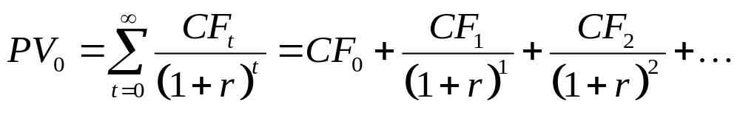
Assets with Multiple Cash Flows
Suppose an asset generates a series of cash flows for its owners
  Value each cash flow separately
  Sum these present values to assign a value to the asset

Slide 7
Multiple Cash Flows: An Example
Consider an asset that generates $5,000 in year 1 and $3,000 in year 5; discount rate = 6%
  View this as a time line that displays the cash flows
Periods
0
1
2
3
4
5
Project 1
Cash flows
$5,000
$3,000
PV?
PV?
∑PV?

Slide 8
Multiple CFs: An Example continued…
Consider an asset that generates $5,000 in year 1 and $3,000 in year 5; discount rate = 6% per year
  To solve, use the basic PV equation and then ∑
    PV = FV_{t} /(1+r)^{t} = $5,000/(1.06)¹ = $4,716.98
    PV = FV_{t} /(1+r)^{t} = $3,000/(1.06)⁵ = $2,241.77
    ∑ = $6,958.75
  Or, use a financial calculator and then ∑
    1n; 6i; 0PMT; 5,000FV; PV = -$4,716.98
    5n; 6i; 0PMT; 3,000FV; PV = -$2,241.77
    ∑ = -$6,958.75

Slide 9
Multiple CFs: An Example continued…
Consider an asset that generates $5,000 in year 1 and $3,000 in year 5; discount rate = 6%
  To solve, use the basic PV equation
Periods
0
1
2
3
4
5
Project 1
Cash flows
$5,000
$3,000
$4,716.98
$2,241.77
$6,958.75

Slide 10
Multiple CFs: An Example continued…
Consider an asset that generates $5,000 in year 1 and $3,000 in year 5; discount rate = 6%
Note: In finding the PV of this asset, we are simply summing the PVs of each individual cash flow
Interpretation: You are indifferent between receiving the future cash flow stream and having $6,958.75 today

Slide 11
Back to the Future (Values that is)
What if you wanted to find future value of a stream of cash flows?
Alternatively, you would be indifferent between receiving the future cash flow stream on the time line and a time period 5 cash flow of ???
Two ways to answer this question:
  Method 1: Compound each cash flow and sum them up
  Method 2: Find PV of each cash flow, sum them up, and then compound the sum

Slide 12
Back to Future Value (and Time Lines)
Consider our example again: Asset generates $5,000 in year 1 and $3,000 in year 5; discount rate = 6%
What is the future value of this cash flow stream?
Periods
0
1
2
3
4
5
Method 1
Cash flows
$5,000
$3,000
$FV??
∑ $FV??
Method 2
Cash flows
$5,000
$3,000
$PV??
$PV??
∑ $PV??
$FV??

Slide 13
Method 1
Formula: FV_{t} = PV*(1+r)^{t} = $5,000*(1.06)⁴ = $6,312.39
Financial Calculator: 4n; 6i; 0PMT; 5,000PV; FV = $6,312.39
Note: For Method 1 period 5 cash flow is already FV (i.e., at time period 5)
Periods
0
1
2
3
4
5
Method 1
Cash flows
$5,000
$3,000.00
Compound at 6% for 4 years
$6,312.39
∑ $9,312.39

Slide 14
Method 2
CF 1 Formula: PV = FV_{t}/(1+r)^{t} = 5,000/(1.06)¹ = $4,716.98
Financial Calculator: 1n; 6i; 0PMT; 5,000FV; PV = $4,716.98
CF 5 Formula: PV = FV_{t}/(1+r)^{t} = 3,000/(1.06)⁵ = $2,241.78
Financial Calculator: 5n; 6i; 0PMT; 3,000FV; PV = $2,241.778
FV Formula: FV_{t} = PV*(1+r)^{t} = 6,958.76*(1.06)⁵ = $9,312.39
Financial Calculator: 5n; 6i; 6,958.76PV; 0PMT; FV = $9,312.39
0
1
2
3
4
5
Method 2
Cash flows
$5,000
$3,000
$4,716.98
Discount at 6% for 1 years
$2,241.78
Discount at 6% for 5 years
∑ $6,958.76
Compound at 6% for 5 years
$9,312.39

Slide 15
Back to Future Value (and Time Lines)
Method 1 and Method 2 provide the same FV of $9,312.39
Periods
0
1
2
3
4
5
Method 1
Cash flows
$5,000
$3,000.00
$6,312.39
$9,312.39
Method 2
Cash flows
$5,000
$3,000
$4,716.98
$2,241.78
$6,958.76
$9,312.39

Slide 16
Special Cases
PV formula holds for any stream of cash flows
Two special cases where the formula simplifies:
    (1) Perpetuity
    (2) Annuity

Slide 17
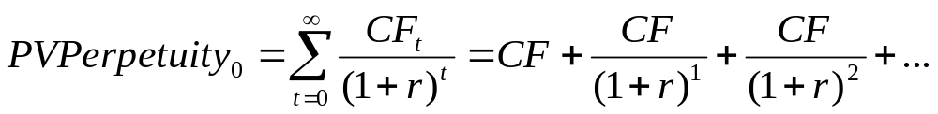
Perpetuity
Present Value of a Perpetuity

Slide 18
Perpetuity
Definition: Steam of level cash flows that never ends
  Cash flow is always in the amount of CF
  First cash flow is in period 1 (i.e., time 0 cash flow is $0)
What does the time line look like?
    Draw it!

Slide 19
Perpetuities and Time Lines
Time line for a perpetuity follows…
Periods
0
1
2
3
4
…
∞
Cash flows
CF₁
CF₂
CF₃
CF₄
…
CF∞

Slide 20
Perpetuities and Time Lines
Determining present value for a perpetuity follows…
Note: You need to determine the present value of an infinite cash flow stream!
Periods
0
1
2
3
4
…
∞
Cash flows
CF₁
CF₂
CF₃
CF₄
…
CF∞
PVCF₁
PVCF₂
PVCF₃
PVCF₄
…
…
PVCF∞
∑ PV∞CFs

Slide 21
Simplifying a Perpetuities
A power series take the form:
a + ax + ax² +ax³ + ax⁴ + … + ax∞,
  and is equivalent to
  a/(1-x)
A perpetuity is a power series with:
a = CF/(1+r)
and
x = 1/(1+r)
So, a/(1-x) becomes…

Slide 22
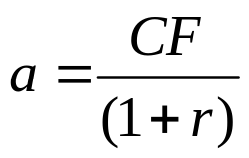
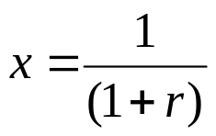

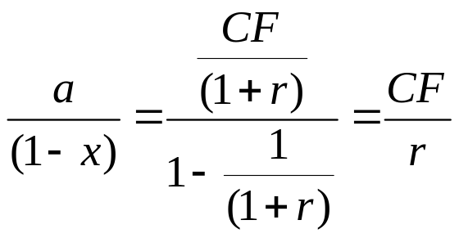
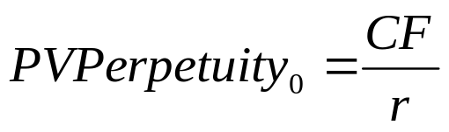
Simplifying a Perpetuities continued…
So, a/(1-x) becomes…

Slide 23
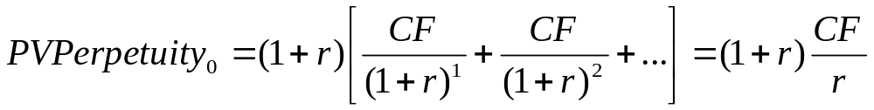
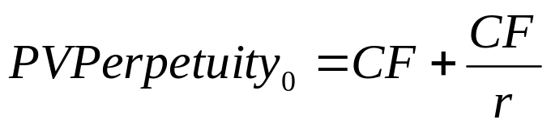
Think About It…
What if the first payment of the perpetuity were to occur at time 0?

Slide 24
Simplifying a Perpetuities Example continued…
What is the present value of $100,000 per year in perpetuity at 10% interest?
Periods
0
1
2
3
4
…
∞
Cash flows
$100,000
$100,000
$100,000
$100,000
…
$100,000
$90,909.09
$82,644.63
$75,131.48
$68,301.35
…
…
∑ PV∞CFs

Slide 25
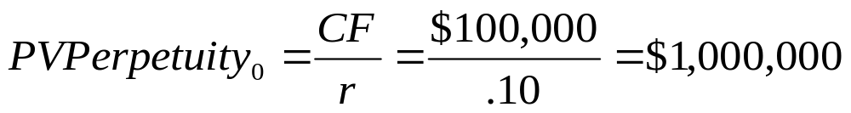
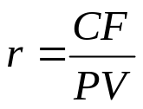

Simplifying a Perpetuities Example continued…
What is the present value of $100,000 per year in perpetuity at 10% interest?
You can easily solve for different numbers in the formula!
  Given PV and CF, what is r?
  Given PV and r, what is CF?

Slide 26
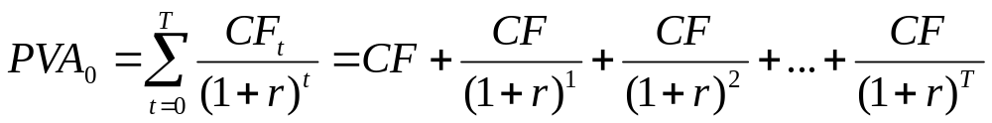
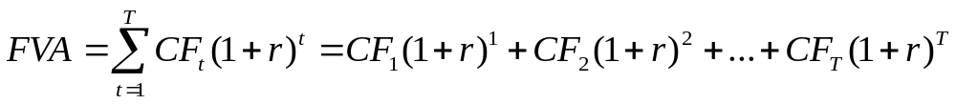
Annuity
Present Value of an Annuity (PVA)
Future Value of an Annuity (FVA)

Slide 27
Present Value of an Annuity (PVA)
Definition: Level stream of cash flows for a limited (finite) period of time discounted back to time 0 at the stated interest rate (i.e., discount rate)
  Cash flow is always in the amount CF
  First cash flow is in period 1 (i.e., time 0 cash flow is $0)
  Last cash flow is in period T
What does the time line look like for PVA?
    Draw it!

Slide 28
PVAs and Time Lines
Time line for a present value of an annuity follows…
Periods
0
1
2
3
4
…
T
Cash flows
CF₁
CF₂
CF₃
CF₄
…
CF_{T}

Slide 29
PVAs and Time Lines
Determining present value for an annuity follows…
  Note: You need to determine the present value of a limited (finite) cash flow stream
Periods
0
1
2
3
4
…
T
Cash flows
CF₁
CF₂
CF₃
CF₄
…
CF_{T}
PVCF
PVCF
PVCF
PVCF
…
…
PVCF
∑ PV of T CFs

Slide 30
Simplifying an Annuity
Consider two perpetuities with the same cash flow (call it CF)
  Perpetuity 1, P1, has first payment at time 1
  Perpetuity 2, P2, has first payment at time T+1
What does the time line look like?
    Draw it!

Slide 31
Simplifying an Annuity continued…
From the time line, we see that the present value of the T-period annuity is simply:
PV(P1)₀ – PV(P2)₀
Periods
0
1
2
3
4
…
∞
P1
Cash flows
CF₁
CF₂
CF₃
CF₄
…
CF_{T}
Periods
T
T+1
T+2
T+3
T+5
∞
P2
Cash flows
CF₁
CF₂
CF₃
CF₄
…

Slide 32
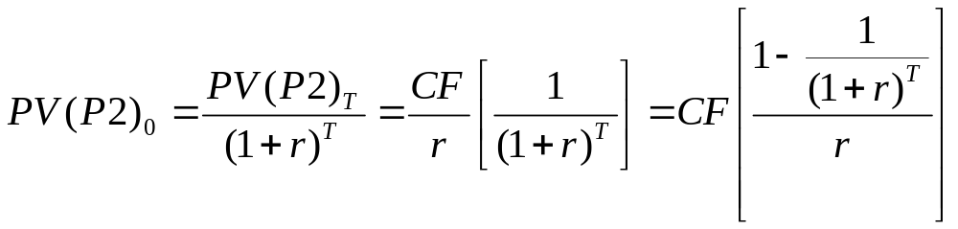
Simplifying an Annuity continued…
We can easily solve for the present values of the two perpetuities as of the periods before the payments start:
  PV(P1)₀ = CF/r
  PV(P2)_{T} = CF/r
But what is PV(P2)₀?
  Just view its present value at time T as a time-T cash flow and discount it to time 0

Slide 33

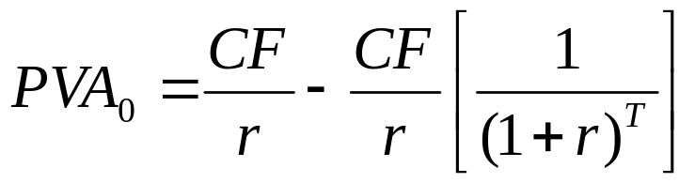
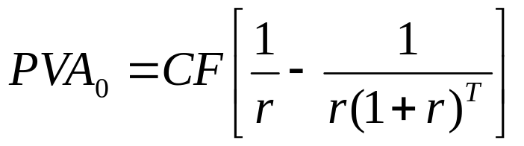
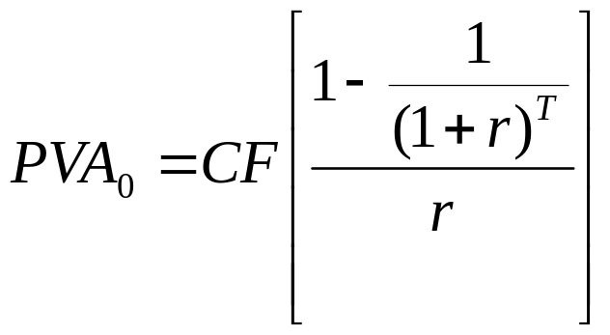
Simplifying an Annuity continued…
Mathematically…

Slide 34
Present Value of an Annuity: Example
Example: What is the present value of $100,000 per year for 3 years at 10%
Periods
0
1
2
3
Cash flows
CF₁
CF₂
CF₃
PVCF₁
PVCF₂
PVCF₃
ΣPVCFs

Slide 35
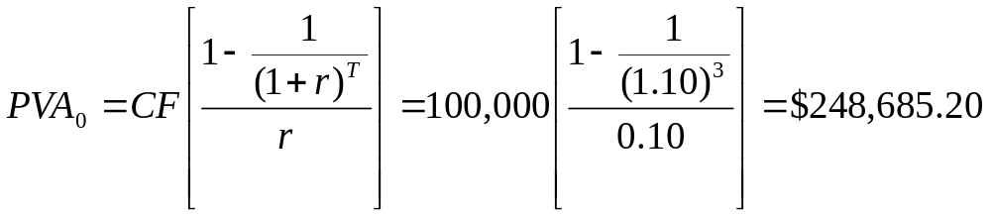
Present Value of an Annuity: Example continued…
Example: What is the present value of $100,000 per year for 3 years at 10%
Formula: PVCF₁ = FVCF₁/(1+r)¹ = $100,000/(1.10)¹ = $ 90,909.09
PVCF₂ = FVCF₂/(1+r)² = $100,000/(1.10)² = $ 82,644.63
PVCF₃ = FVCF₃/(1+r)³ = $100,000/(1.10)³ = $ 75,131.48
$248,685.20
Formula:
Financial Calculator: 3n; 10i; 100,000PMT; PV = $248,685.20

Slide 36
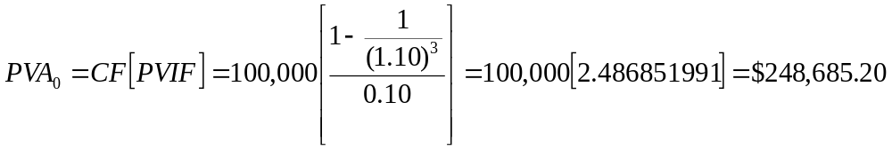
Present Value of an Annuity: Example continued…
Present Value Annuity Factor (PVIF): Factor the payment is multiplied by in order to calculate PV
Formula:
PVIF:

Slide 37
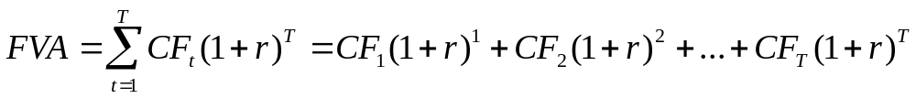
Future Value of an Annuity
How can you calculate the future value of an annuity?
Definition: Level stream of cash flows for a limited (finite) period of time compounded to the future at a stated interest rate
  Cash flow is always in the amount CF
  First cash flow is in period 1 (i.e., time 0 cash flow is $0)
  Last cash flow is in period T
    What does time line look like? Draw it!

Slide 38
Future Value of an Annuity
Time line for future value of an annuity follows…
Periods
0
1
2
3
Cash flows
CF₁
CF₂
CF₃
FVCF₃
FVCF₂
FVCF₁
ΣFVCFs

Slide 39
Future Value of an Annuity: An Example
Example: What is the future value of $100,000 per year for 3 years at 10%
Periods
0
1
2
3
Cash flows
CF₁
CF₂
CF₃
$100,000
$110,000
$121,000
$331,000

Slide 40
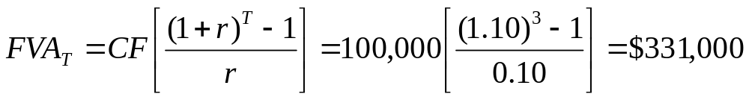
Future Value of an Annuity: An Example
Example: What is the future value of $100,000 per year for 3 years at 10%
Formula: FVCF₁ = PVCF₁*(1+r)² = $100,000*(1.10)² = $121,000.00
FVCF₂ = PVCF₂*(1+r)¹ = $100,000*(1.10)¹ = $110,000.00
FVCF₃ = PVCF₃*(1+r)⁰ = $100,000*(1.10)⁰ = $100,000.00
$331,000.00
Formula:
Financial Calculator: 3n; 10i; 100,000PMT; FV = $331,000.00

Slide 41
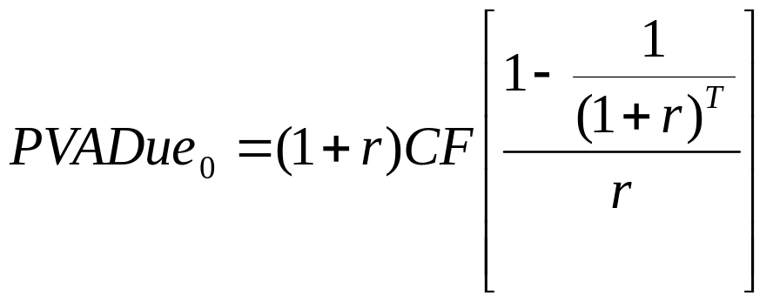
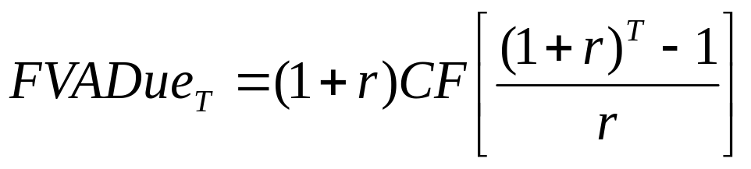
Annuity Due
Present Value of an Annuity Due
Future Value of an Annuity Due

Slide 42
Present Value of an Annuity Due
Definition: Present value of an annuity with first payment at time 0 (instead of time 1)
Amounts to discounting one less period than with an ordinary annuity
Multiply present value of an ordinary annuity by (1+r)

Slide 43
Present Value of an Annuity Due: Time Line
Time line for the present value of an annuity due follows…
Periods
0
1
2
3
Cash flows
PVCF₀
CF₁
CF₂
PVCF₁
PVCF₂
ΣPVCFs

Slide 44
Present Value of an Annuity Due: An Example
Example: What is the present value of an annuity due with three cash flows of $100,000 at a rate of 10%?
Periods
0
1
2
3
Cash flows
$100,000.00
CF₂
CF₃
$ 90,909.09
$ 82,644.63
$273,553.72

Slide 45
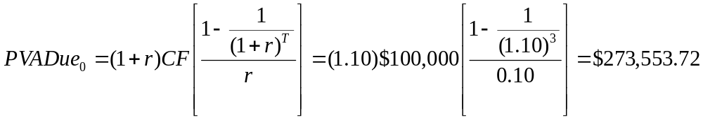
Present Value of an Annuity Due: An Example
Example: What is the present value of an annuity due with three cash flows of $100,000 at a rate of 10%?
Formula: PVCF₀ = FVCF₀/(1+r)⁰ = 100,000/(1.10)⁰ = $100,000.00
PVCF₁ = FVCF₁/(1+r)¹ = 100,000/(1.10)¹ = $ 90,909.09
PVCF₂ = FVCF₂/(1+r)² = 100,000/(1.10)² = $ 82,644.63
$273,553.72
Formula:
Financial Calculator: Set Due: 3n; 10i; 100,000PMT; PV = $273,553.72

Slide 46

Future Value of an Annuity Due
Definition: Future value of an ordinary annuity with the first payment at time 0 (instead of time 1)
Amounts to compounding one period more than with an ordinary annuity
Multiply ordinary annuity FV by (1+r)

Slide 47
Future Value of an Annuity Due: An Example
What does the time line look like for the future value of an annuity due? Draw it…
Periods
0
1
2
3
Cash flows
CF₀
CF₁
CF₂
FVCF₂
FVCF₁
FVCF₀
ΣFVCFs

Slide 48
Future Value of an Annuity Due: An Example
Example: What is the future value of $100,000 per year for 3 years at 10%
Periods
0
1
2
3
Cash flows
CF₀
CF₁
CF₂
$110,000.00
$121,000.00
$133,100.00
$364,100.00

Slide 49
Future Value of an Annuity Due: An Example
Example: What is the future value of $100,000 per year for 3 years at 10%
Formula: FVCF₀ = PV*(1+r)³ = 100,000*(1.10)³ = $133,100.00
FVCF₁ = PV*(1+r)² = 100,000*(1.10)² = $121,000.00
FVCF₂ = PV*(1+r)¹ = 100,000*(1.10)¹ = $110,000.00
$364,100.00
Formula:
Financial Calculator: Set Due: 3n; 10i; 100,000PMT; FV = $364,100.00

Slide 50
Back to Our Original Three Projects
Can you determine which project provides the best value creation if all project cash flows are discounted at 5%?
Periods
0
1
2
3
4
5
Project 1
Cash flows
($4,000)
$5,000
Project 2
Cash flows
($4,000)
$1,000
$1,000
$1,000
$1,000
$1,000
Project 3
Cash flows
($4,000)
$2,500
$2,500

Slide 51
Projects 1
What is present value of all cash flows for project 1 discounted at 5%?
Periods
0
1
2
3
4
5
Project 1
Cash flows
($4,000.00)
$5,000
$4,535.15
$ 535.15

Slide 52
Project 2
What is the present value of all cash flows for project 2 discounted at 5%?
Periods
0
1
2
3
4
5
Project 2
Cash flows
($4,000)
$1,000
$1,000
$1,000
$1,000
$1,000
$952.38
$907.03
$863.84
$822.70
$783.53
$329.48

Slide 53
Project 2
Note: There is an annuity in project 2!
Financial Calculator: 5n; 5i; 1,000PMT; PV = $4,329.48 - $4,000 = $329.48
Periods
0
1
2
3
4
5
Project 2
Cash flows
($4,000)
$1,000
$1,000
$1,000
$1,000
$1,000
$952.38
$907.03
$863.84
$822.70
$783.53
$329.48

Slide 54
Project 3
What is the present value of all cash flow from project discounted at 5%?
Periods
0
1
2
3
4
5
Project 3
Cash flows
($4,000)
$2,500
$2,500
$2,380.95
$2,056.76
$ 437.71

Slide 55
Back to Our Original Three Projects
Project 1: Net Cash Flows = $535.15
Project 2: Net Cash Flows = $329.48
Project 3: Net Cash Flows = $437.71
Which project provides the best value creation?

Slide 56
We now know how to do Present and Future Values of Single Cash flows and Multiple Cash Flows!

Slide 57
Thank you
Thank You!
Charles B. (Chip) Ruscher, PhD
Department of Finance and Business Economics

